Slide 1


D-Light
ERASMUS+ KA2 Partnership Project

Slide 2
We focus on the mental health of older adults.
For this, it is necessary to address certain areas in order to design exercises for the users.
It is also necessary for professionals to have a tool for optimal follow-up.
A virtual reality application has been designed for this purpose.

Slide 3
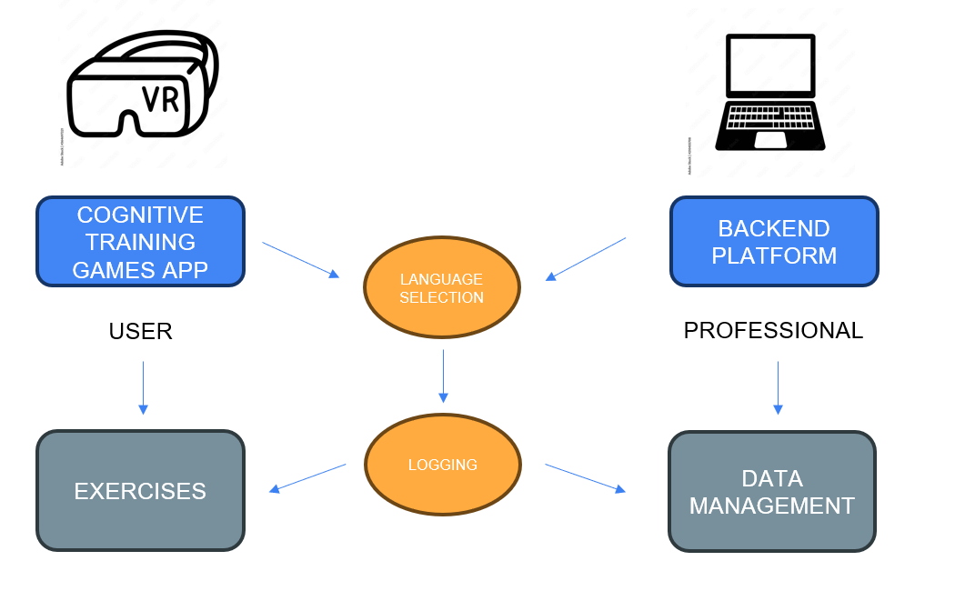

Slide 4


Slide 5
User

Slide 6
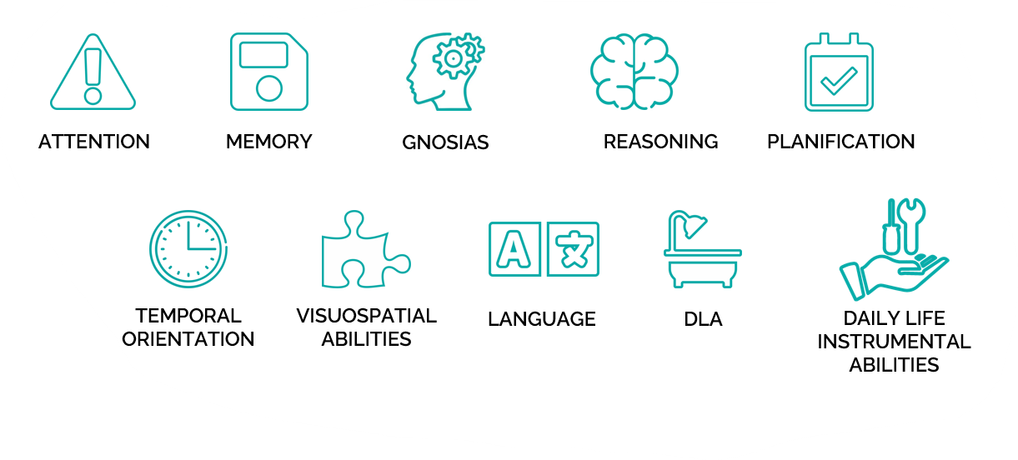

Slide 7
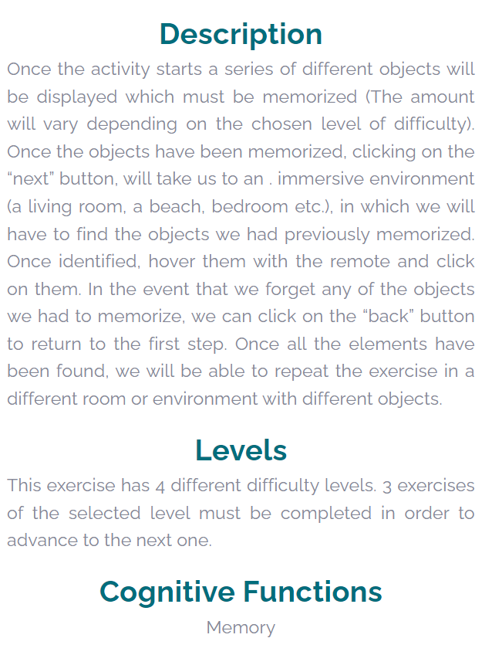
Exercise 1:
Find the objects

Slide 8
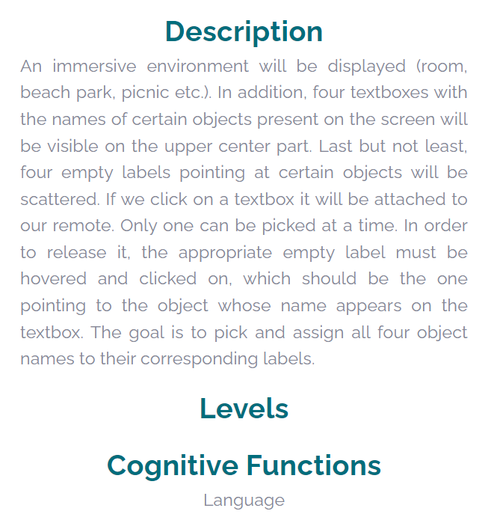
Exercise 2:
Name the objects

Slide 9
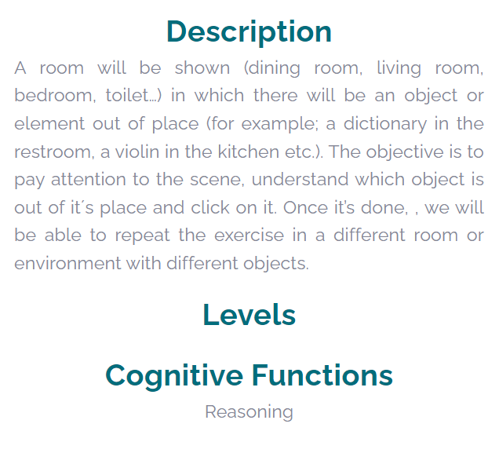
Exercise 3:
Find the one out of place

Slide 10
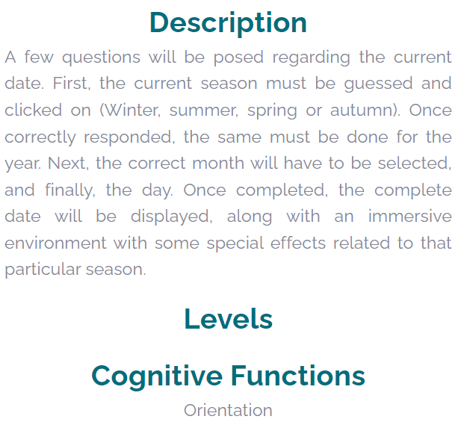
Exercise 4:
Set the date

Slide 11
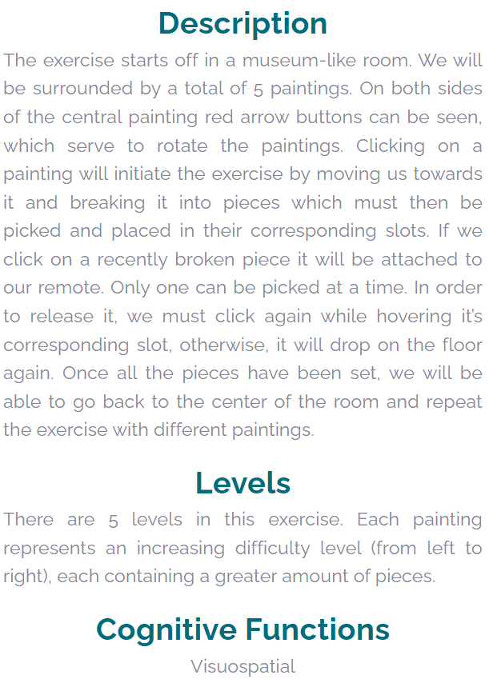
Exercise 5:
Puzzle

Slide 12
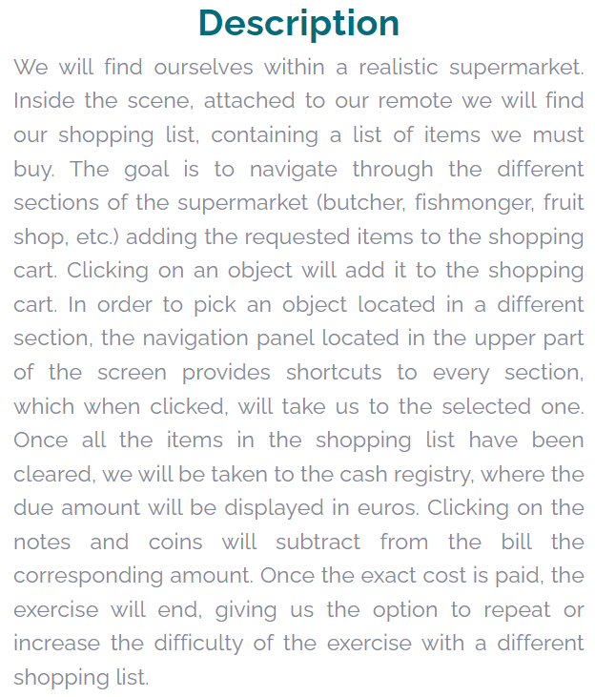
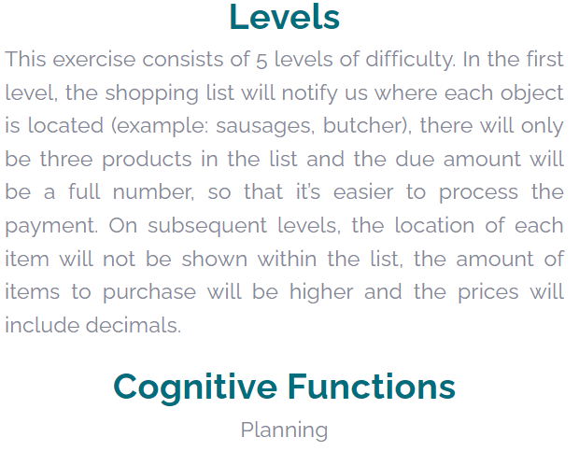
Exercise 6:
Supermarket

Slide 13
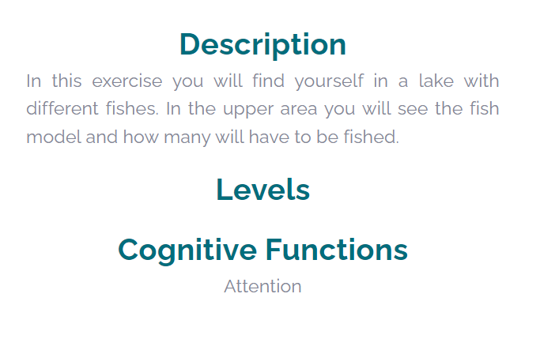
Exercise 7:
Fishing

Slide 14
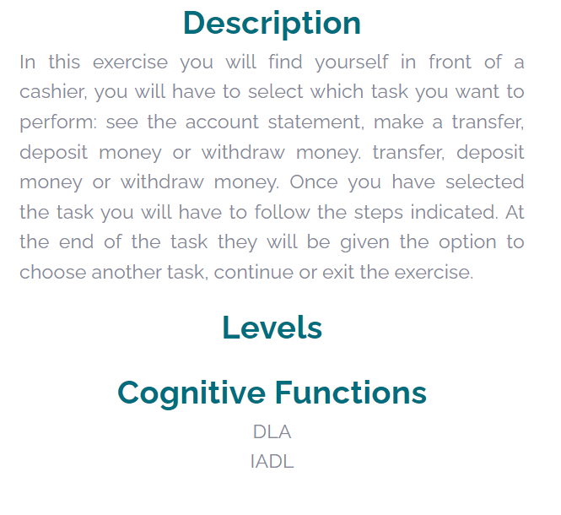
Exercise 8:
ATM

Slide 15
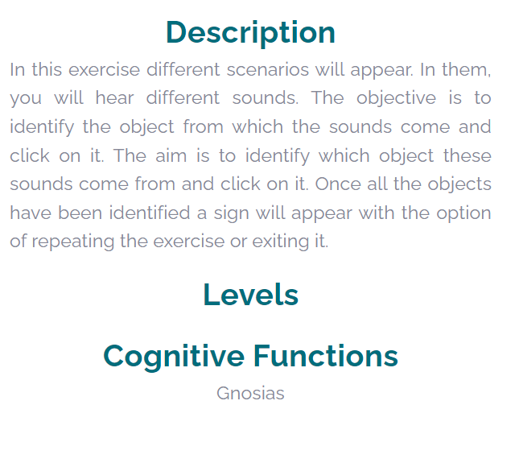
Exercise 9:
Identify the sounds

Slide 16
Professional

Slide 17
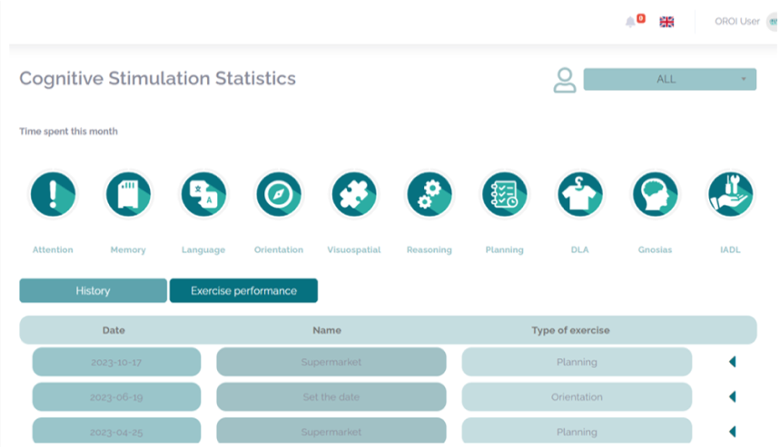
Backend Platform

Slide 18
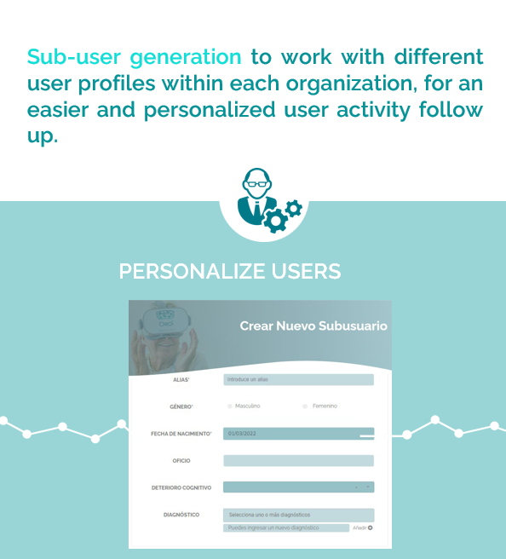

Slide 19
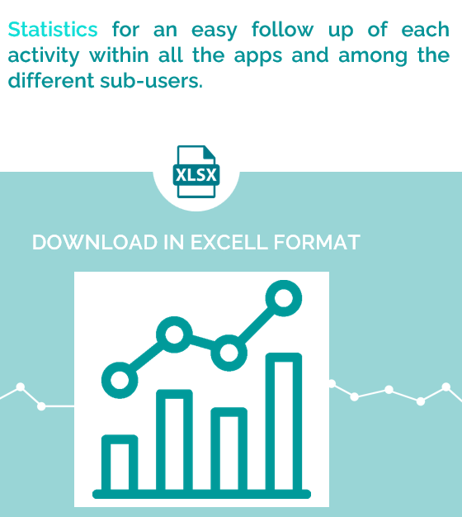

Slide 20

Thank you for your attention

